Slide 1


Information Technology

Slide 2
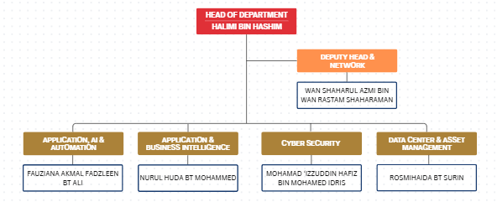
IT ORGANIZATION CHART

Slide 3
Each student will get a student ID, email and default password. Example:
Email : A12200xxx@student.dhu.edu.my
Password : Default password
01
Student Account
Student can connect to DRB-HICOM U Wifi. The WiFi cover all area of Campus and University Village
02
DRB-HICOM U WiFi
Moodle use for find lecture notes, assignments, quizzes, announcement etc.
Office 365 is a line of subscription services offered by Microsoft which adds to and includes Ms Office
product line
Moodle, Office 365
03
To view and access all of information such as programme & subject enrolled into, timetable, exam results, financial statement, extra curriculum, create feedback/response.
04
Student Portal
PAGE 3

Slide 4




DRB-HICOM U WiFi
DRB-HICOM U have multiple SSID :
DHU STAFF
DHU STUDENT
DHU GUEST
DHU_Staff_UV
DHU_Student_UV
Access for every level

Slide 5
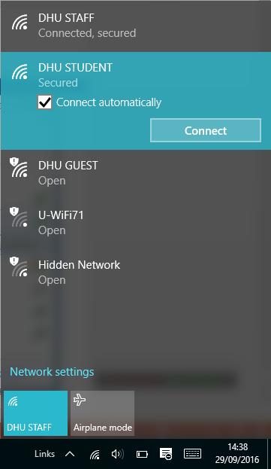
STEPS IN ACCESSING
STUDENT WIFI
STEP 1:
Choose DHU STUDENT
SSID

Slide 6
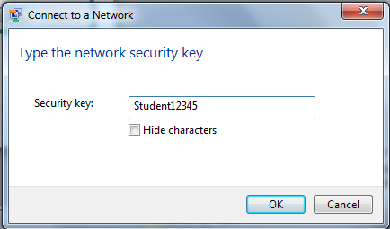
STEPS IN ACCESSING
STUDENT WIFI
STEP 2:
Key In the SECURITY KEY
Security Key: Student12345

Slide 7
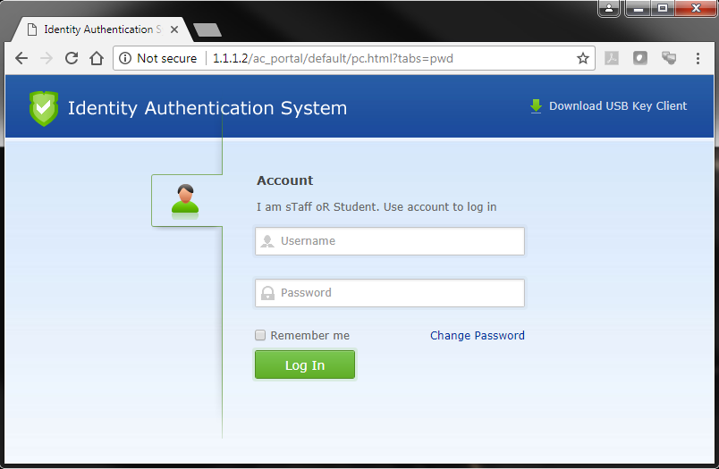
STEPS IN ACCESSING
STUDENT WIFI
STEP 3:
Authentication Page Login
Username: 201234567
Password: xxxxxxx
If not appear automatically, please open your browser and type
1.1.1.2

Slide 8


Please do not enter wrong password exceed 3 times. Your account will be locked.
Your password will be expired within 3 month.

Slide 9







INTERNET ACCESS

Slide 10








Slide 11
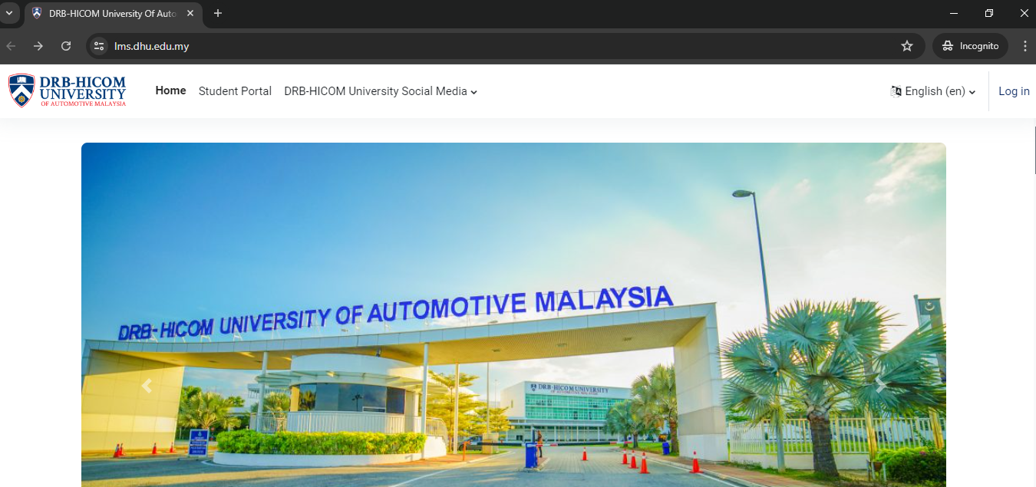
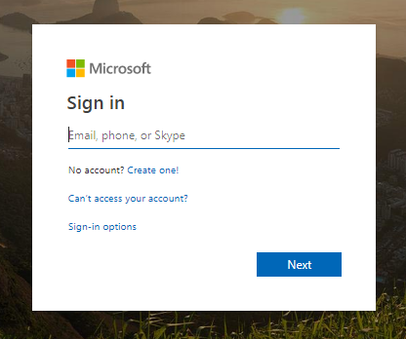
MOODLE [LEARNING MANAGEMENT SYSTEM]
https://lms.dhu.edu.my

Slide 12
HOW TO ENROL MOODLE
Login to Moodle
Select your faculty
Find your lecturer’s name
Find your subject
Enroll yourself (first time only)
Then, access your notes, assignment etc.

Slide 13
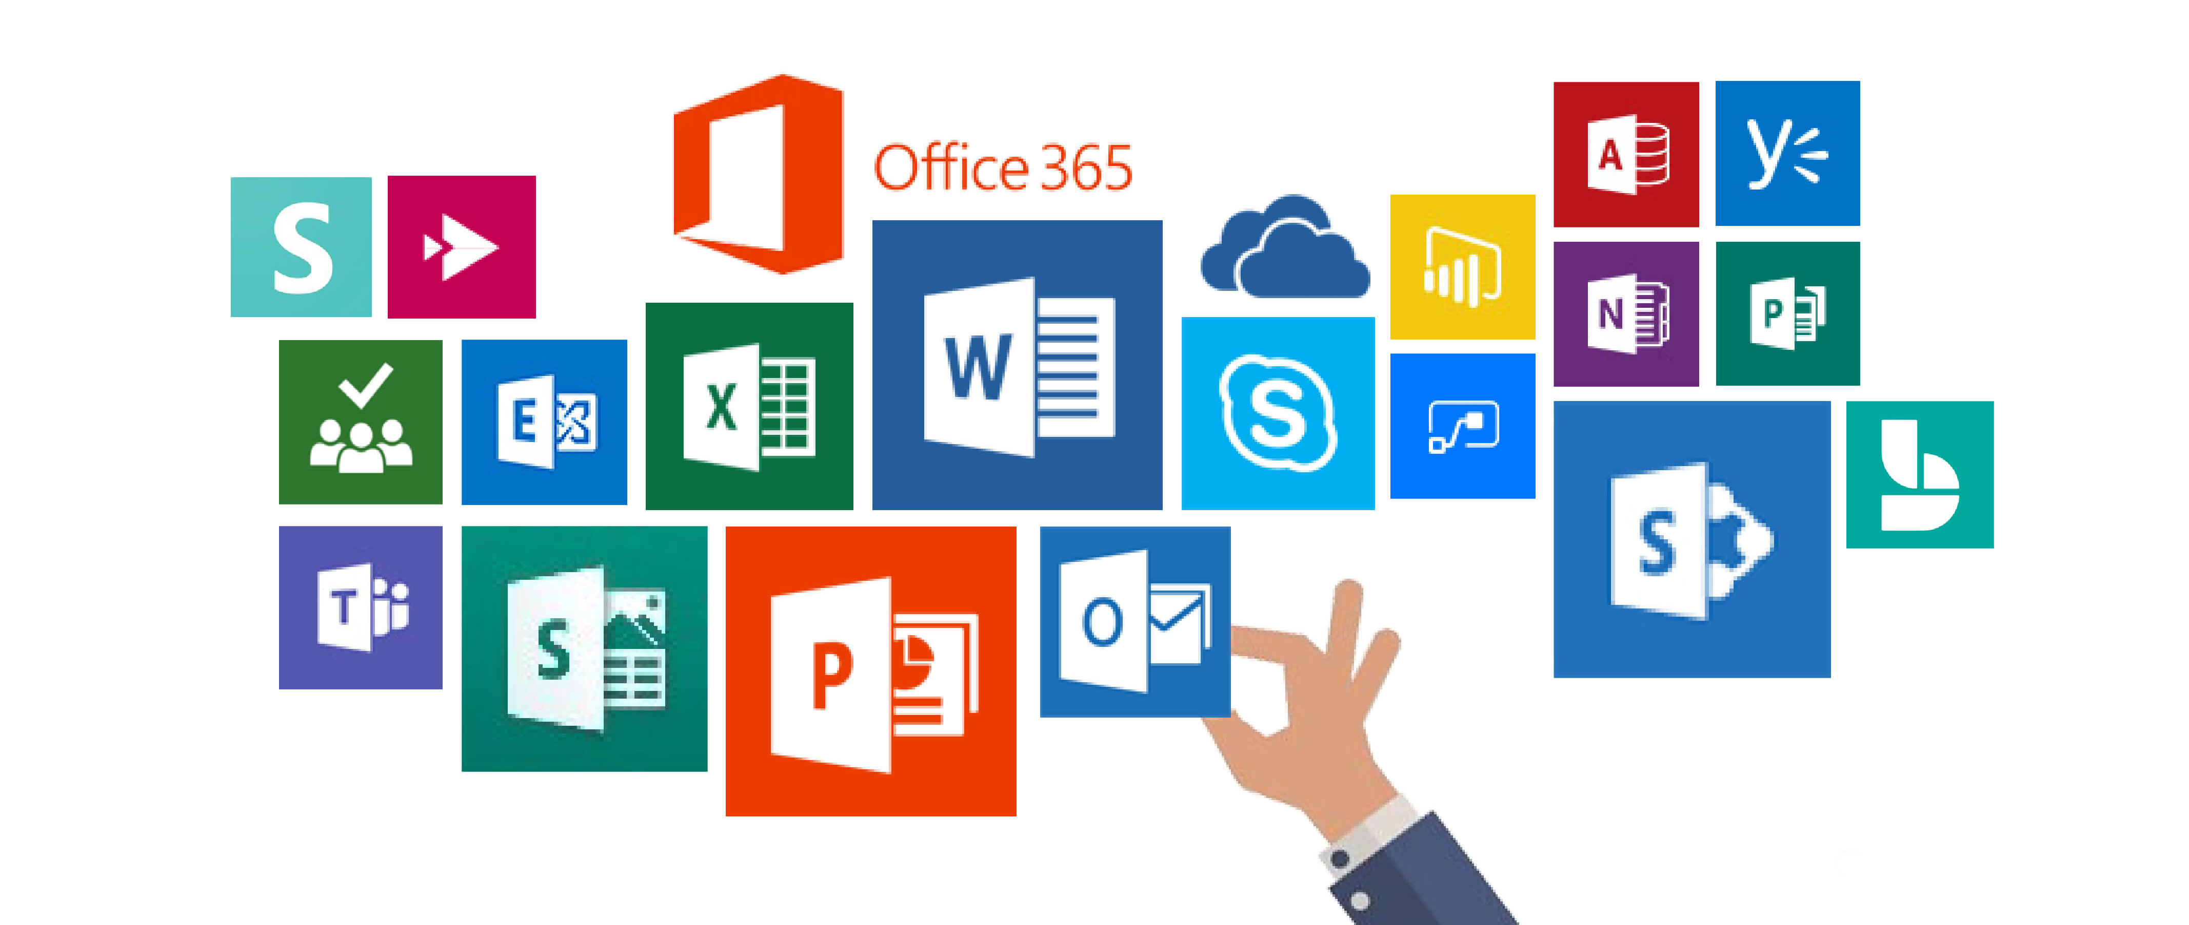
EXPLORE MICROSOFT OFFICE 365

Slide 14
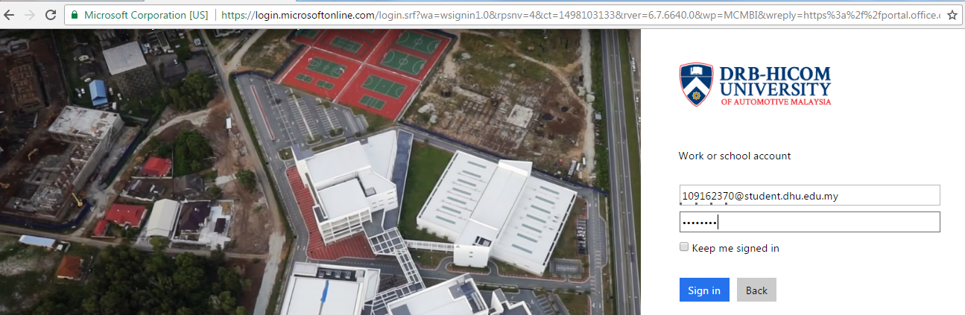
OFFICE 365
http://portal.office.com
Username : xxxxx@student.dhu.edu.my [Student email]
Password : [Student Password]

Slide 15
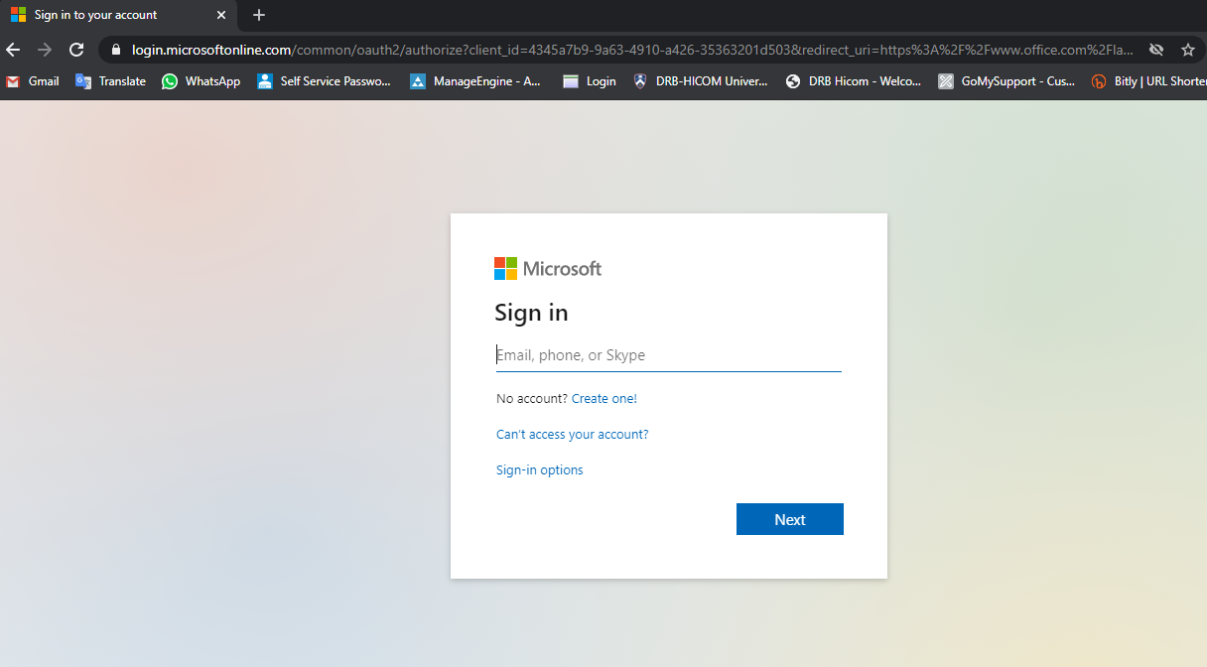
LOGIN TO OFFICE 365
portal.office.com

Slide 16
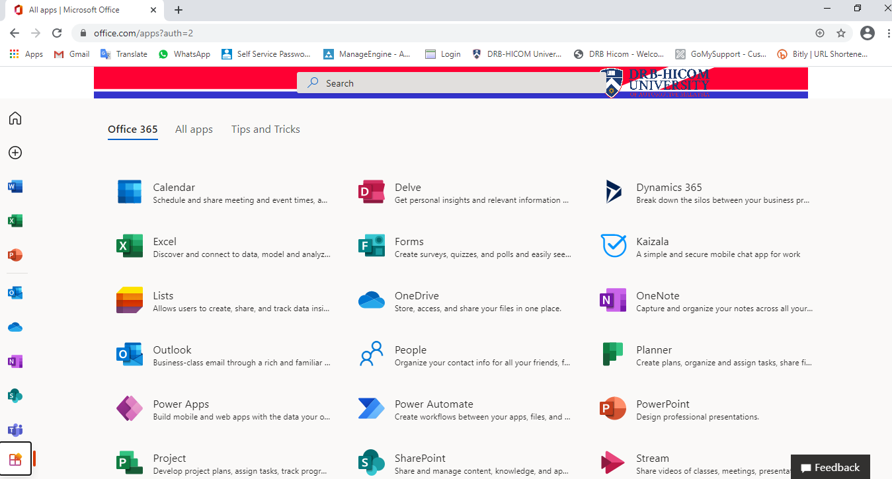
ALL APPS IN OFFICE 365

Slide 17
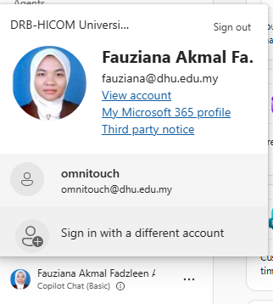
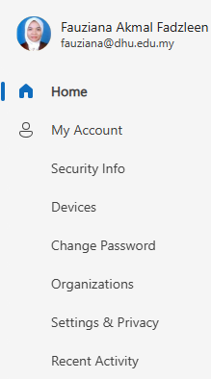
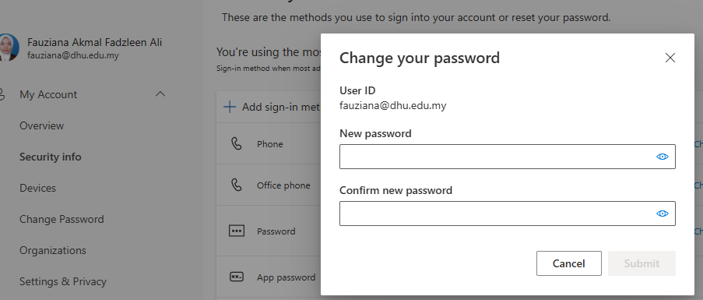
HOW TO CHANGE PASSWORD AT OFFICE 365
Minimum password length: 8 characters
Password complexity: enable (must include alphanumeric [a combination of uppercase and lower-case letters and numbers] as well as symbols/special characters)

Slide 18

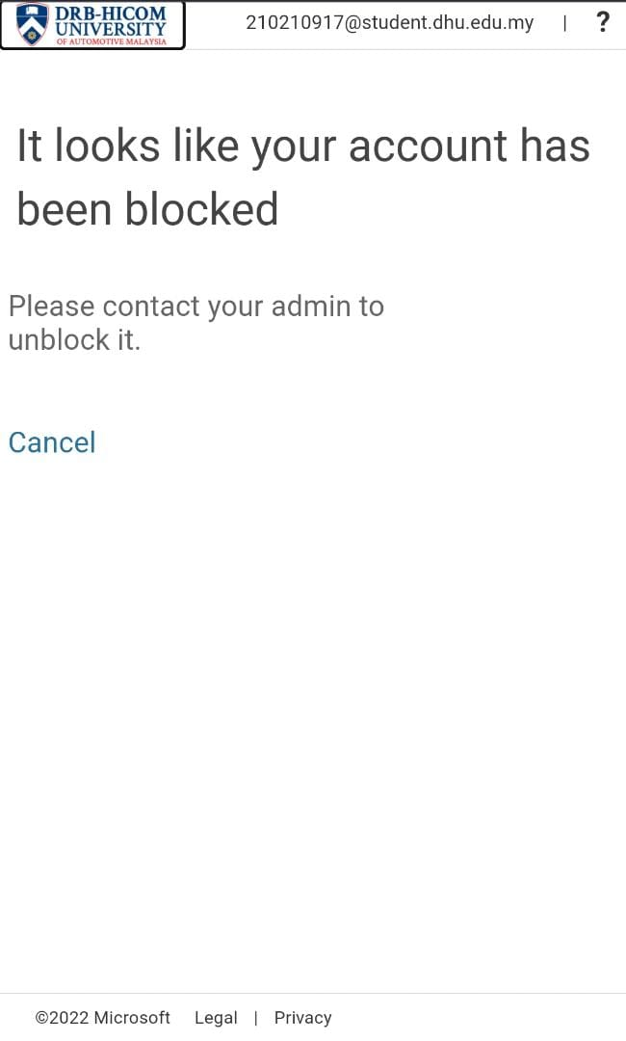
GUIDE HOW TO ADD SECURITY VERIFICATION & CHANGE PASSWORD
MFA : Multi-factor Authentication

Slide 19
Microsoft Form
TOP APPLICATION FOR STUDENT
Outlook
OneDrive
Microsoft Teams

Slide 20
Microsoft Forms is an
online survey creator, part of Office 365. Released by Microsoft in June 2016, Forms allows users to create surveys and quizzes with automatic marking.
The data can be exported
to Microsoft Excel.

Slide 21
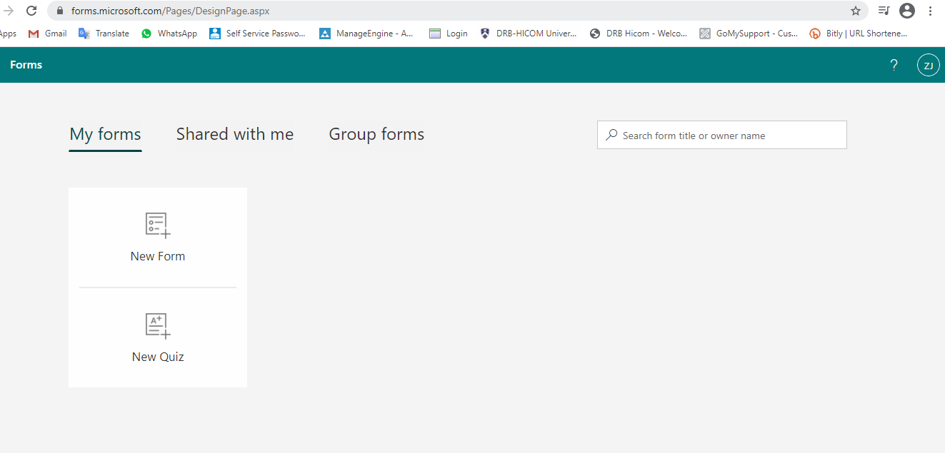
MICROSOFT FORM

Slide 22
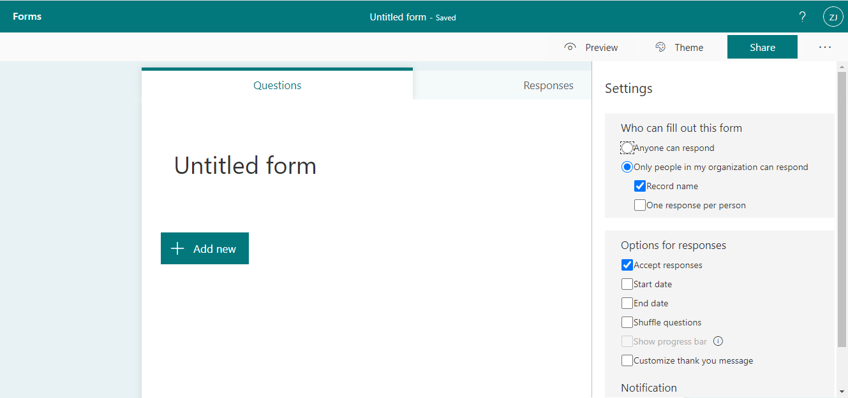
MICROSOFT FORM

Slide 23
OUTLOOK
01
02
03
Microsoft Outlook is an application that is used mainly to send and receive emails.
It can also be used to manage various types of personal data including calendar appointments and similar entries, tasks, contacts, and notes.
Outlook is available for Windows desktops and mobiles as well as the Mac, iOS and Android.
Attachment file only 20MB
Cannot accept Zip & RAR format

Slide 24
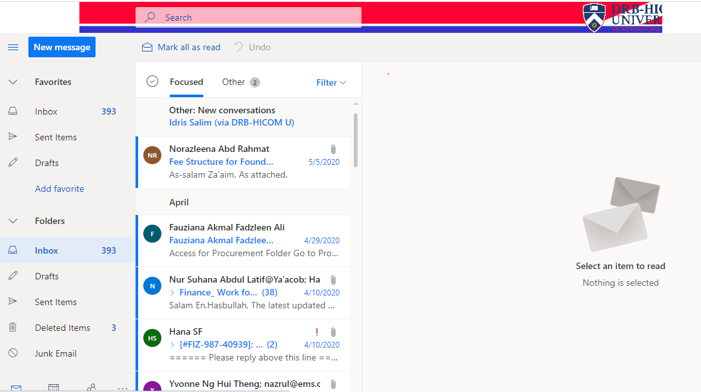
OUTLOOK

Slide 25
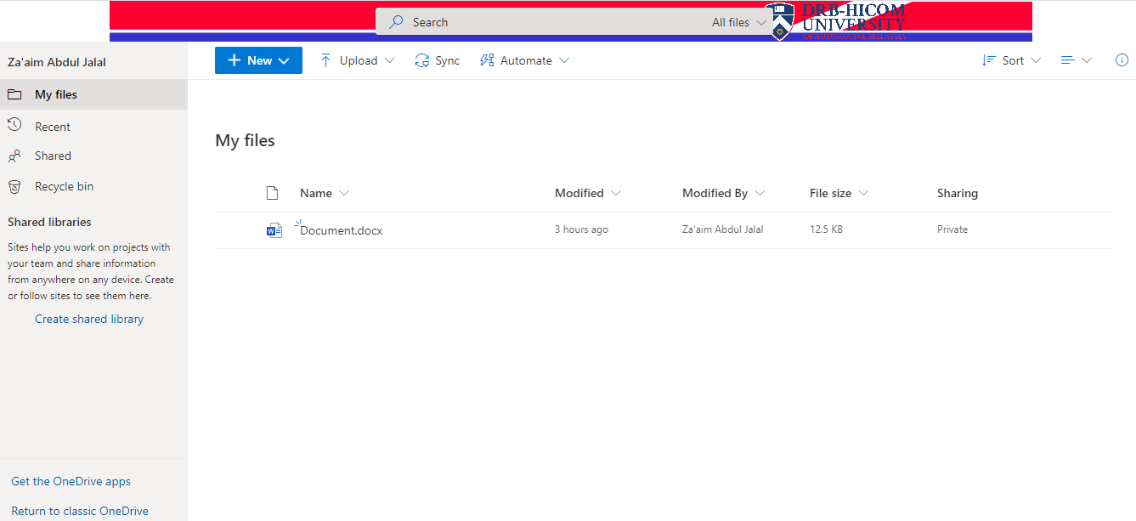
ONE DRIVE

Slide 26
Microsoft Teams is a proprietary business communication platform developed by Microsoft, as part of the Microsoft 365 family of products. Teams primarily competes with the similar service Slack, offering workspace chat
and videoconferencing, file
storage, and application
integration.

Slide 27
MICROSOFT TEAMS
PIC / Lecturer add student into team and student will get the email.
How to Join a Microsoft Team ?
Get Link to team
Code

Slide 28
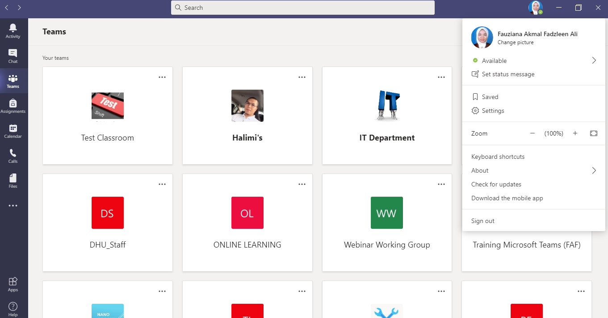
MICROSOFT TEAMS

Slide 29
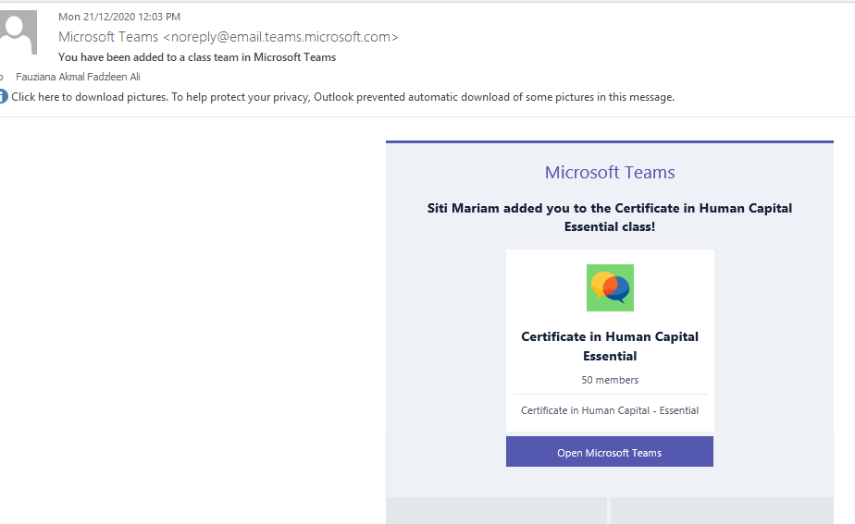
MICROSOFT TEAMS

Slide 30
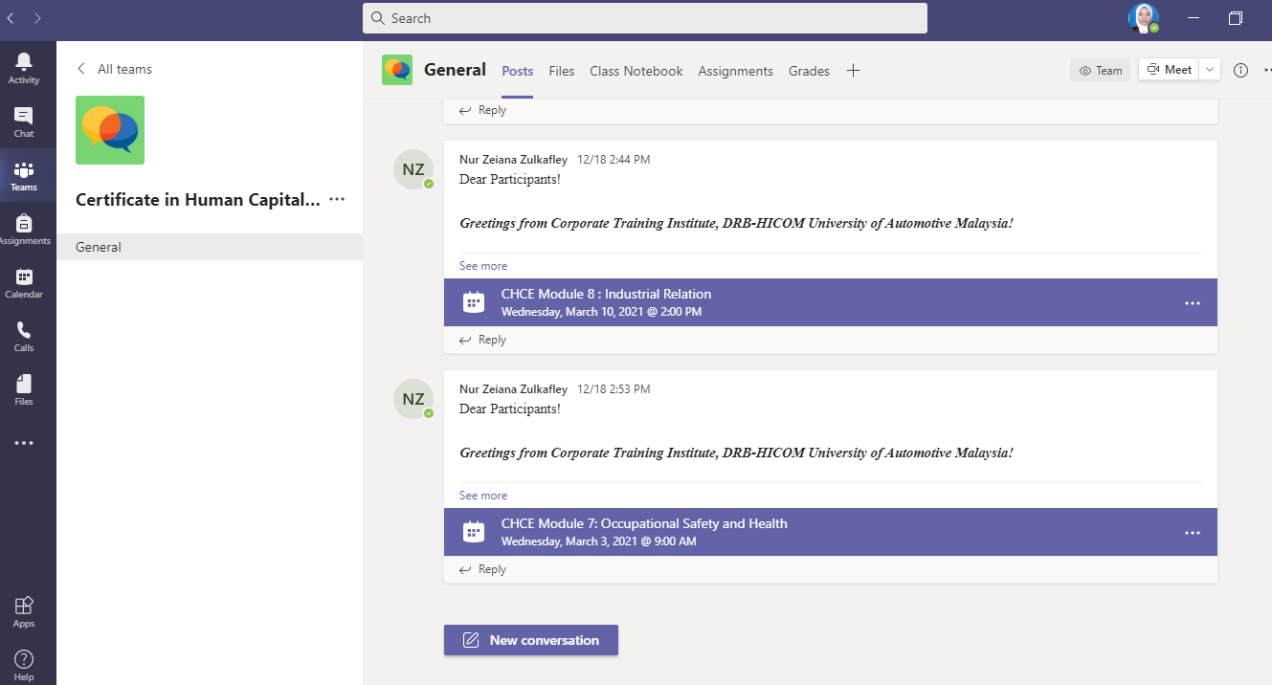
MICROSOFT TEAMS

Slide 31
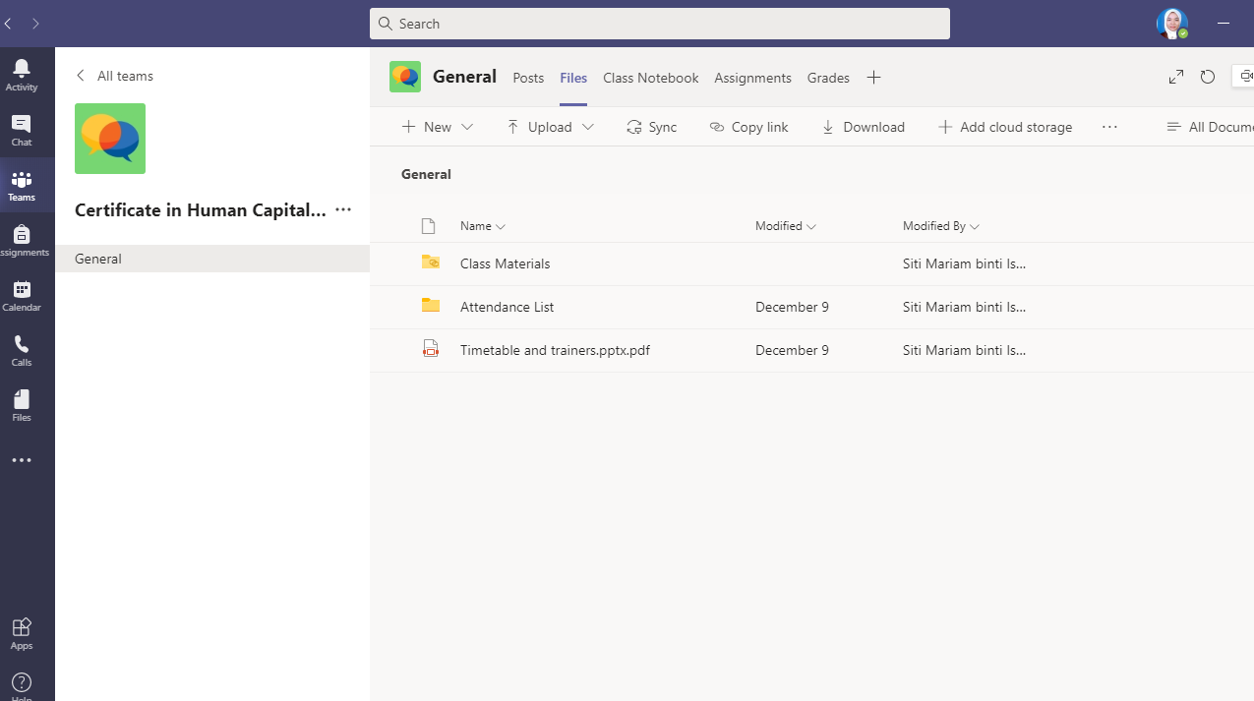
MICROSOFT TEAMS

Slide 32
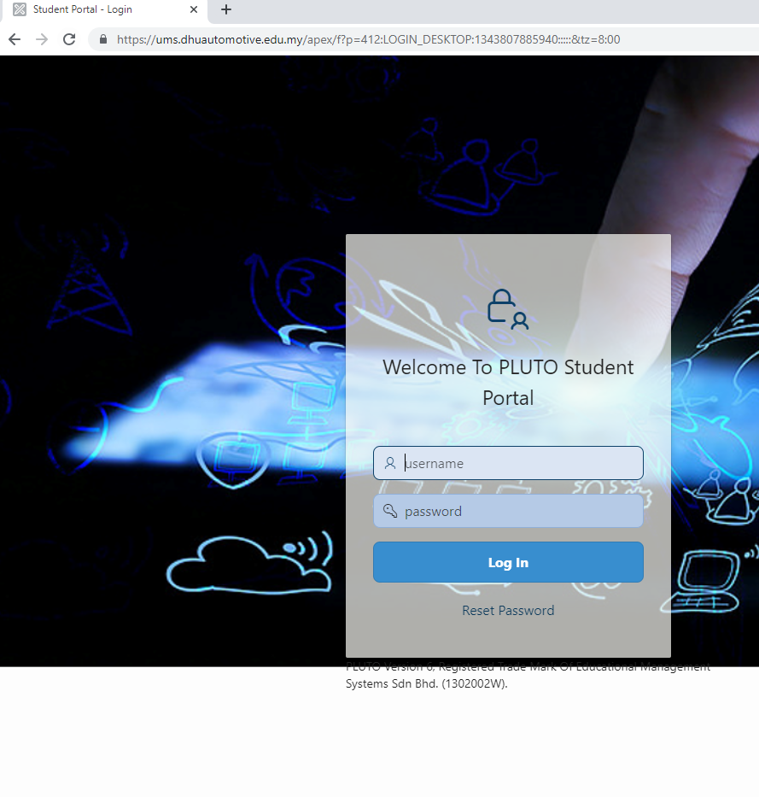
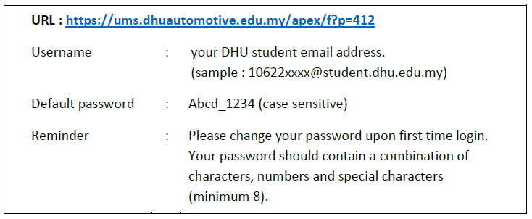
STUDENT PORTAL

Slide 33
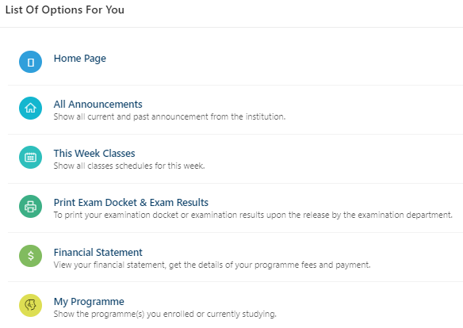
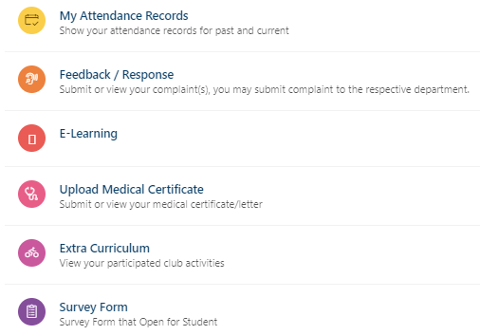
STUDENT PORTAL

Slide 34

LEEN
fauziana@dhu.edu.my
09-4242449

